Slide 1
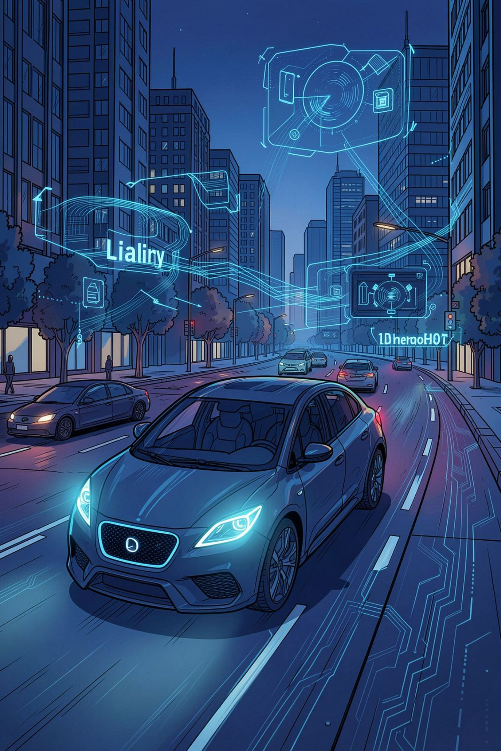
BDD100K Multi-Task Perception Pipeline
Object Detection + Drivable-Area Segmentation
Phase 3: Modeling, MLOps & Pipeline Integration
Kiyan Amini, Armin Nezafat, Mohammad Amin Tahmasebi
Data Science Final Project

Slide 2


From Phase 1/2 to a Refined Phase 3 Scope
Phase 1
Phase 2
BDD100K dataset chosen; task defined as supervised object detection + segmentation
PostgreSQL schema, import pipeline, EDA, Docker/Kubernetes, CI/CD via GitHub Actions
Scope Correction in Phase 3
Traffic-Sign Head
Original plan had 4 heads (detection, lane detection, drivable-area segmentation, traffic-sign recognition)
"Traffic sign" turned out to be just one class inside detection, not its own head
Lane Detection Dropped
Final Scope
Lane detection formally dropped after verifying (via colorized mask visualization) that no usable lane-mask data existed in the accessible dataset mirror
2-task model — object detection (10 classes) + drivable-area segmentation (3 classes)

Slide 3


Shared-Backbone Multi-Task Design
Detection Head
Faster R-CNN RPN + ROI heads
Shared ResNet-50 + FPN
Segmentation Head
Lightweight decoder with transposed convs
One ResNet-50 + FPN backbone (pretrained ImageNet/COCO), computed once per image, feeding two heads — not two separate models
Why Shared
Detection Head
Roughly halves parameter and activation memory vs. two independent backbones — critical on an 8GB GPU
torchvision Faster R-CNN region-proposal + ROI heads
Segmentation Head
Implementation
Lightweight custom decoder (transposed convolutions) upsampling FPN's top feature map to full resolution
Manually wired backbone → RPN → ROI heads instead of treating Faster R-CNN as a black box, so both heads reuse the same features
Trade-off
Loss
Simpler decoder (no U-Net skip connections) → less sharp mask edges, accepted for time
loss = (det_weight × detection_loss) + (seg_weight × segmentation_loss), both weights configurable

Slide 4
Key Architectural Clarification
What Training Reads
Database's Real Role in Phase 3
Training reads images, detection labels, and drivable-area masks directly from disk — NOT from the Phase 2 PostgreSQL database
EDA — class imbalance, weather/scene distribution
Storing model predictions for later comparison against ground truth
Phase 2 Scripts Renamed/Re-documented
Phase 2 scripts renamed/re-documented for clarity (e.g. load_data.py → eda_load_data.py) to reflect true EDA-only purpose

Slide 5

Building the PyTorch Dataset — Real Issues Caught
Category-Name Mismatches
Explicit JSON "labels": null
e.g. "person" vs correct "pedestrian", "motor" vs "motorcycle" — would have silently dropped boxes with no error
Crashed the loader — fixed by treating null and missing key the same way
Degenerate Bounding Boxes
Mask Resizing
Zero/negative width or height filtered out — these produce NaN in box-regression loss
Masks resized with NEAREST interpolation, not bilinear — mask values are class IDs; bilinear blending would invent invalid intermediate classes

Slide 6
Methodology Corrections for Valid Evaluation
Initial Risk
Fix
BDD100K's official "val" split was used both for checkpoint selection AND as a stand-in test set — data leakage, since true test labels are withheld publicly
Labeled "train" split (~70k images) subsampled and internally divided into a real training subset + validation subset (checkpoint selection only); original "val" split reserved as a genuinely untouched held-out test set
Compute Constraint
Training Pool
Full ~70k images was impractically slow on an 8GB GPU
Subsampled to 10,000 images (fixed seed, reproducible), split 85% train / 15% validation

Slide 7






MLflow Experiment Tracking
Centralised tracking of all experiment parameters, metrics, and models, enabling comprehensive comparisons and reproducible results.
Run Configuration
Per-Epoch Metrics
Epochs, batch size, learning rate, and specific detection/segmentation loss weights are meticulously logged for every training run.
Granular metrics, including train and validation loss, are logged for each epoch, distinctly separated by detection and segmentation tasks.
Best Model Checkpoint
Direct Comparison
The model checkpoint achieving the lowest validation loss is automatically identified and saved, ensuring optimal performance is retained.
Facilitates direct comparison of different configurations, a critical requirement for evaluating and selecting superior setups.
Prediction Storage
Metadata-First Design
Predictions are saved as mask PNG files on disk, with file paths and summary statistics (% direct/alt-drivable) in the database, alongside detection boxes, labels, scores, and the MLflow run ID.
A deliberate design choice ensures databases store metadata and pointers, not large binary blobs, optimising storage and access efficiency.

Slide 8

Orchestration: train_pipeline.py and predict_pipeline.py
Train: Prep
Train: Model
Train: Train & Log
Train: Save Best
Each stage is an independent Prefect @task — real retries and observability
MLflow Logging
Predictions Saved As
Logs hyperparameters (epochs, batch size, lr, det/seg weights, backbone config) and per-epoch train/val loss, enabling comparison across runs
Mask PNG on disk + file path/summary stats (% drivable) + detection boxes/labels/scores in the database — avoids bloating the DB with binary data

Slide 9
Diagnosing NaN Losses Methodically
01
02
Symptom
Method
Both detection and segmentation losses were NaN from the very first training step
Disabled mixed precision (AMP) and added degenerate-bounding-box filtering as two candidate fixes, tested together
03
04
Result
Recovery
NaN losses disappeared entirely; losses decreased steadily, confirming real learning
AMP safely re-enabled once the box filter was in place — recovering memory savings without reintroducing instability

Slide 10

Docker + docker compose (v2), and Issues Resolved
GPU Passthrough
Shared Memory
Via NVIDIA Container Toolkit; CUDA-enabled PyTorch installed explicitly (plain PyPI wheels are CPU-only)
shm_size increased for DataLoader workers (default 64MB caused bus errors)
Dockerfile Layer Ordering
Postgres Healthcheck
Optimized so CUDA/torch installs aren't invalidated by unrelated requirements.txt edits
pg_isready + service_healthy condition — fixed "connection refused" race condition
Volume Mounts & Disk
Output Buffering
Fixed volume mounts for missing dataset files; resolved full-disk build failures via cache cleanup
Training falsely appeared frozen due to Python's stdout buffering in Docker — fixed with PYTHONUNBUFFERED=1

Slide 11

Infrastructure Debugging Log
Postgres "password authentication failed"
Pipeline container started before Postgres ready
Resolved via docker compose down -v to reset the volume and reinitialize credentials.
Fixed with a pg_isready healthcheck and depends_on: condition: service_healthy in docker-compose.yml.
Dataset files missing inside container
Full-disk build failures
Addressed via correct volume mounts to present the dataset at runtime, rather than baking large data into the image.
Resulting from accumulated Docker layers/images; resolved via periodic docker system prune -a and manual cleanup.
Training loop appeared frozen
NVIDIA driver/library mismatch
Traced to Python's default stdout buffering in Docker; fixed with PYTHONUNBUFFERED=1 in the environment.
Encountered after an unclean shutdown; resolved via a full system reboot to reset the GPU state.

Slide 12
Results
[insert final metrics: detection mAP / per-class AP, segmentation mean IoU / pixel accuracy]
[insert example prediction visualizations: detected boxes + predicted drivable mask overlay]

Slide 13





Key Takeaways
Careful Scope Correction
Traffic-sign folding and lane-detection removal were deliberate scope corrections over blind adherence to the original plan — prioritizing realistic delivery within project constraints.
Shared-Backbone Multi-Task Design
The shared ResNet-50 + FPN backbone gives real efficiency gains under hardware constraints (8GB GPU), enabling both detection and segmentation without separate model pipelines.
Rigorous Data-Leakage Prevention
A genuinely held-out test set (separate from BDD100K's official validation split) ensures valid evaluation and prevents overfitting to validation data during checkpoint selection.
Full MLOps Loop
End-to-end pipeline: Prefect orchestration for scheduling, MLflow tracking for experiment management, Docker deployment for reproducibility and portability.
Honest, Methodical Debugging
NaN losses, label mismatches, infrastructure issues — all diagnosed and resolved systematically. Debugging is part of the engineering process, not a sign of failure.

